Slide 1
CHAPTER-14
FACTORISATION

Slide 2
TOPICS
FACTORS OF NATURAL NUMBERS & ALGEBRAIC EXPRESSION
2. METHOD OF COMMON FACTORS
3. FACTORISATION BY REGROUPING TERMS
4. SOLVING SUMS ON FACTORISING EXPRESSIONS
5. SOLVING SUMS ON FACTORISION USING IDENTITES
6. FACTORS OF THE FORM (x + a) (x + b)
7. DIVISION OF ALGEBRAIC EXPRESSION

Slide 3
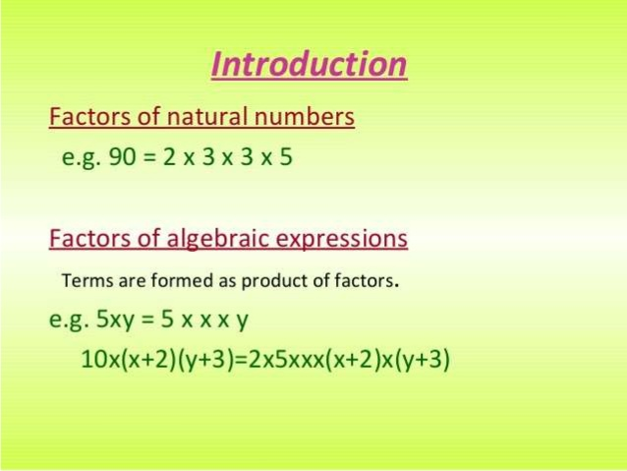

Slide 4
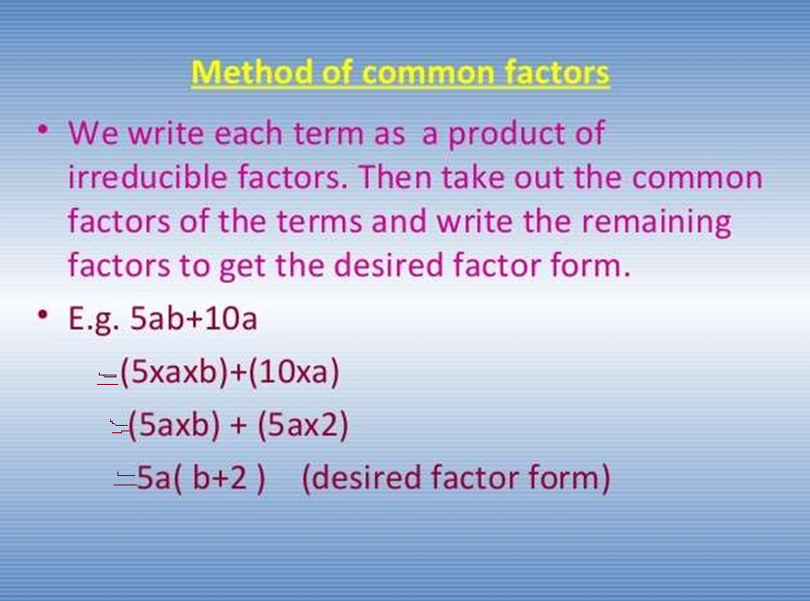

Slide 5
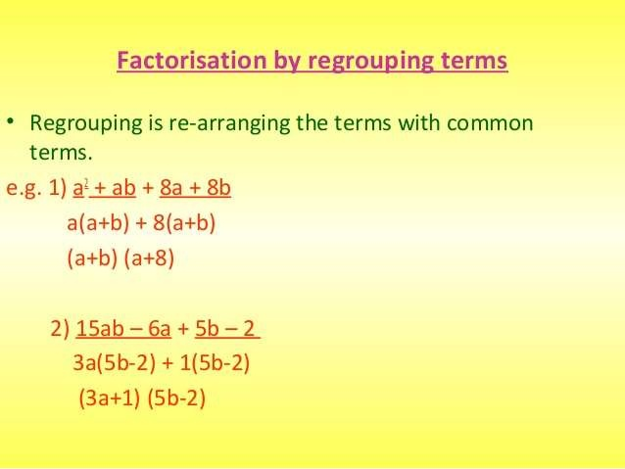

Slide 6
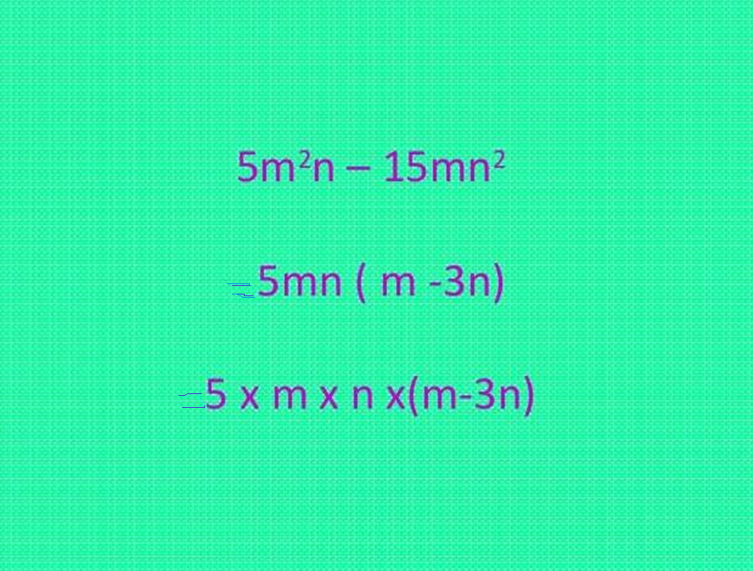

Slide 7
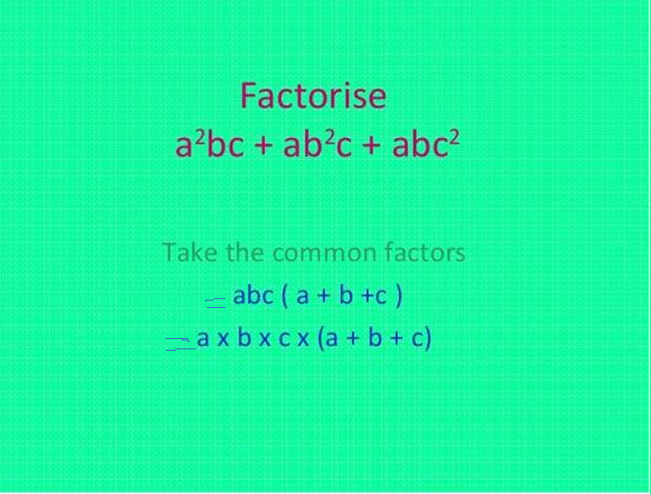

Slide 8
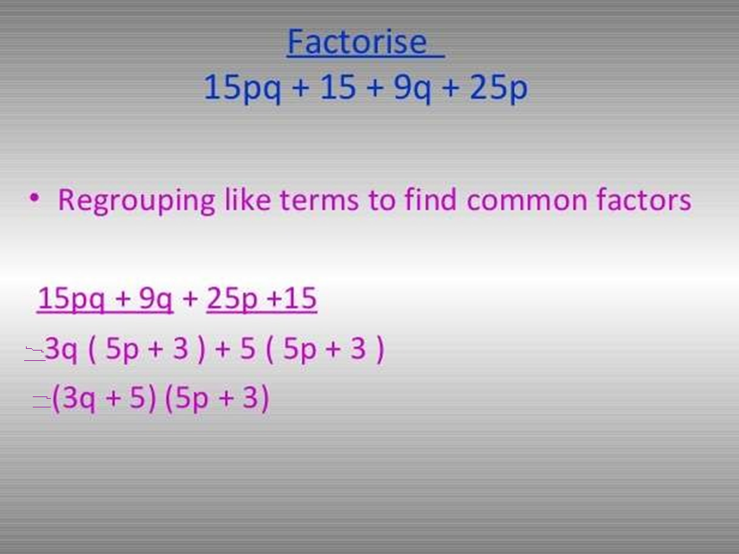

Slide 9
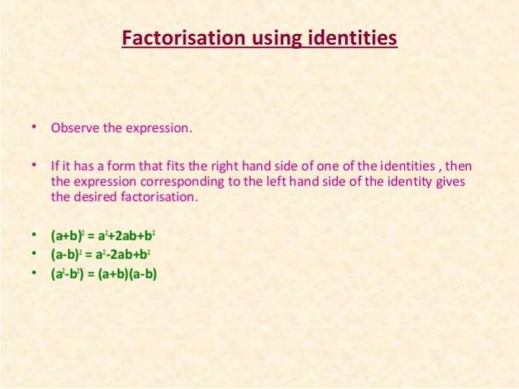

Slide 10
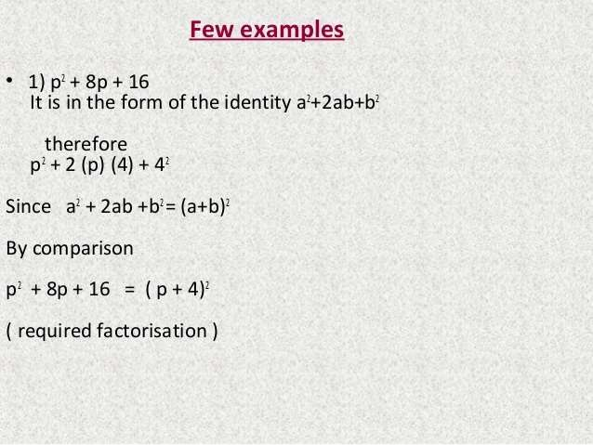

Slide 11
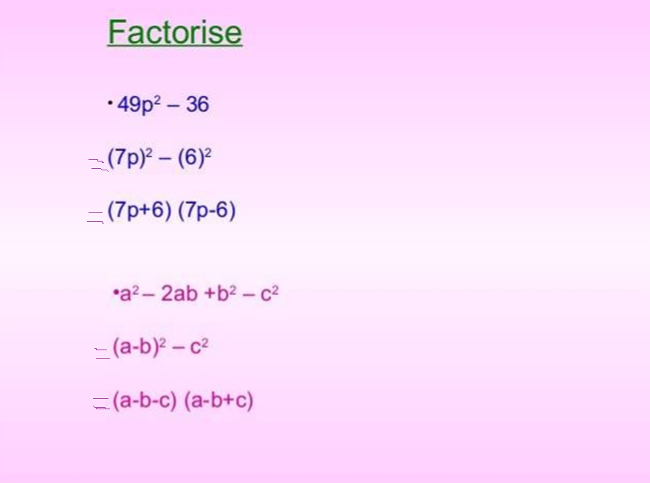

Slide 12
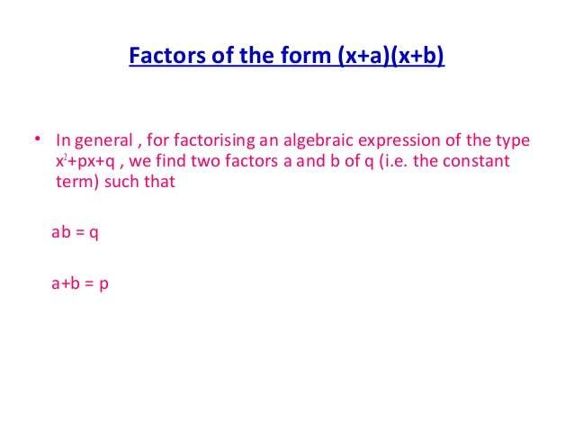

Slide 13
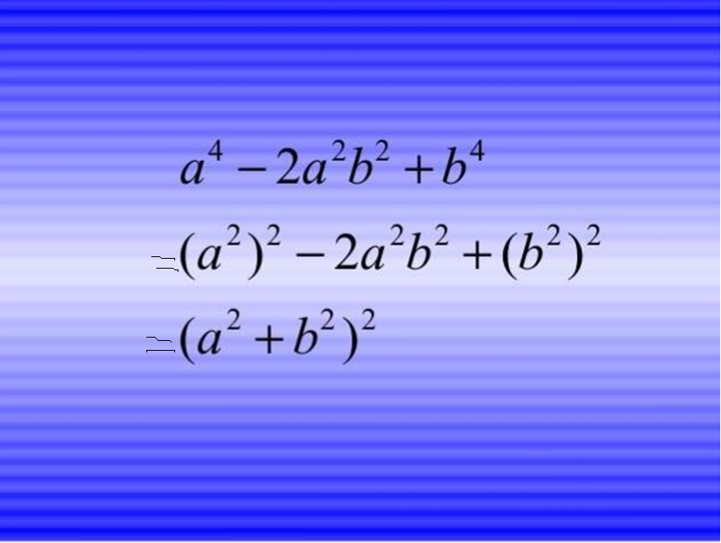

Slide 14
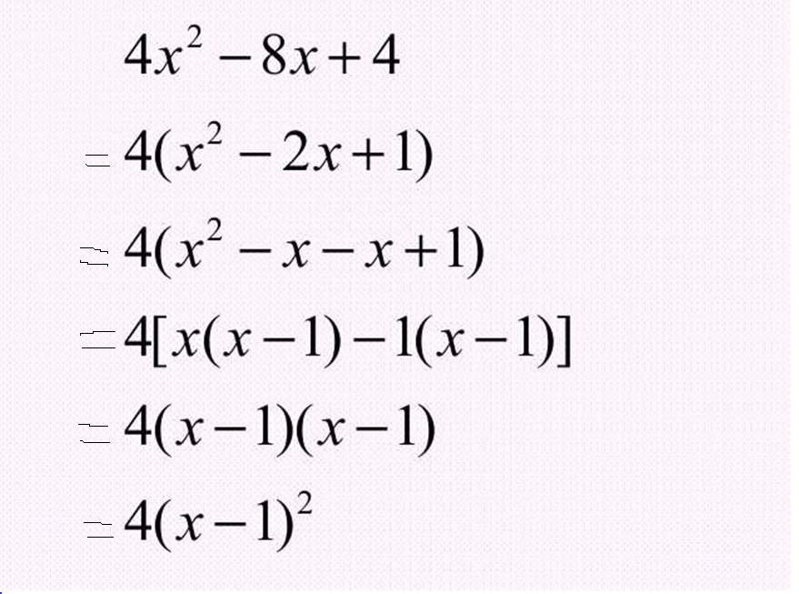

Slide 15
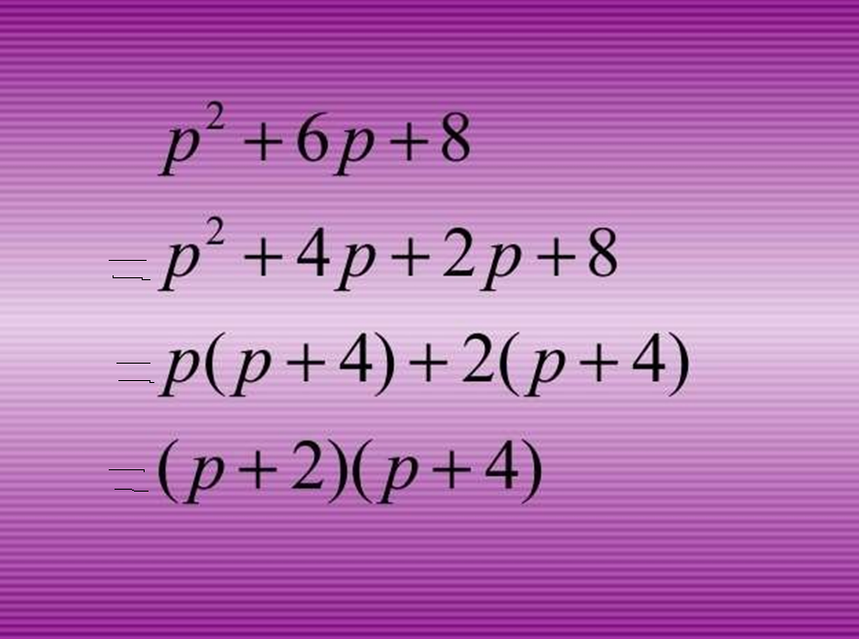

Slide 16
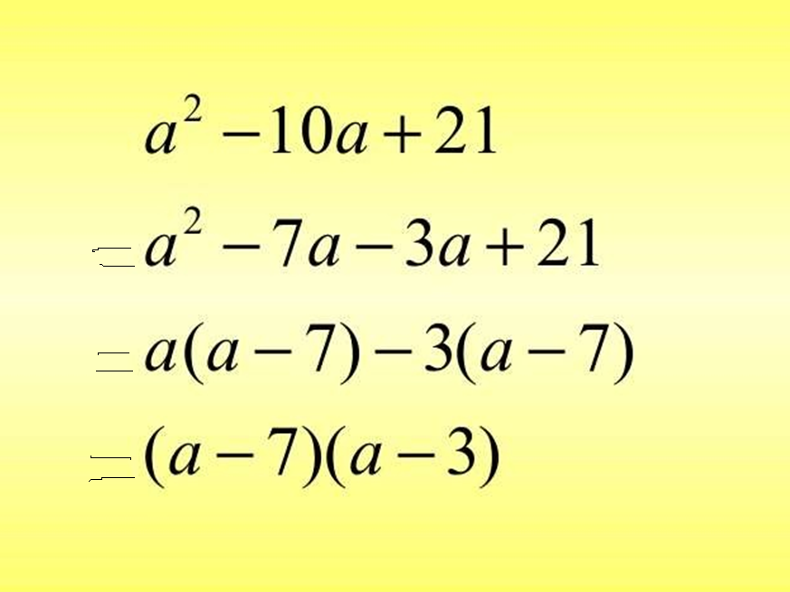

Slide 17
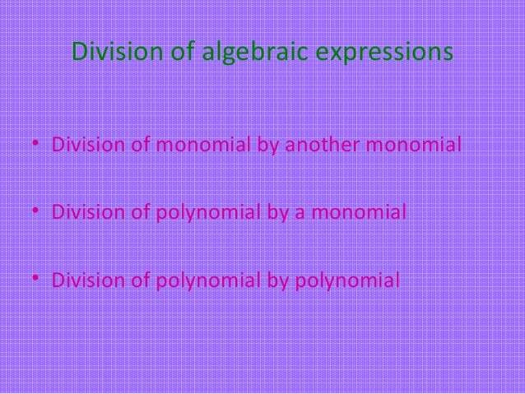

Slide 18




Slide 19
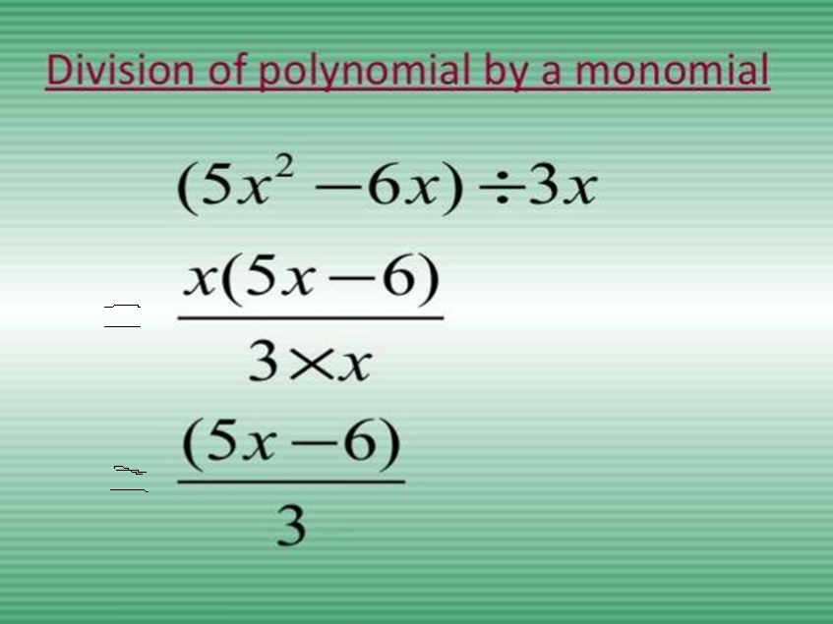

Slide 20
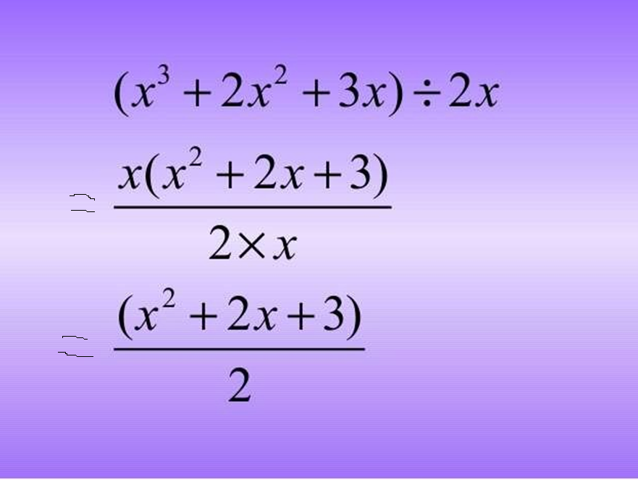

Slide 21
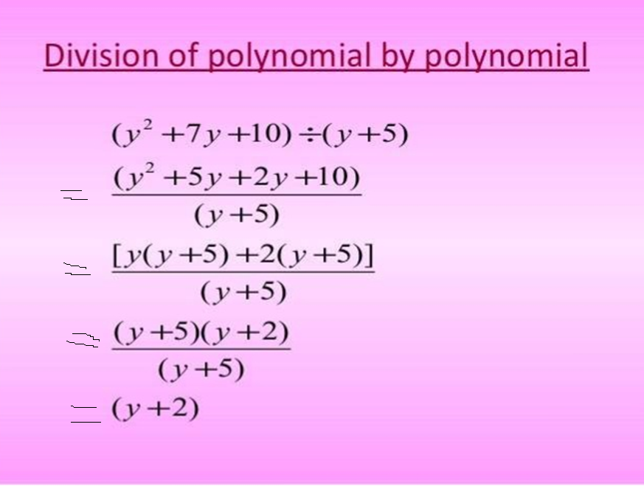

Slide 22
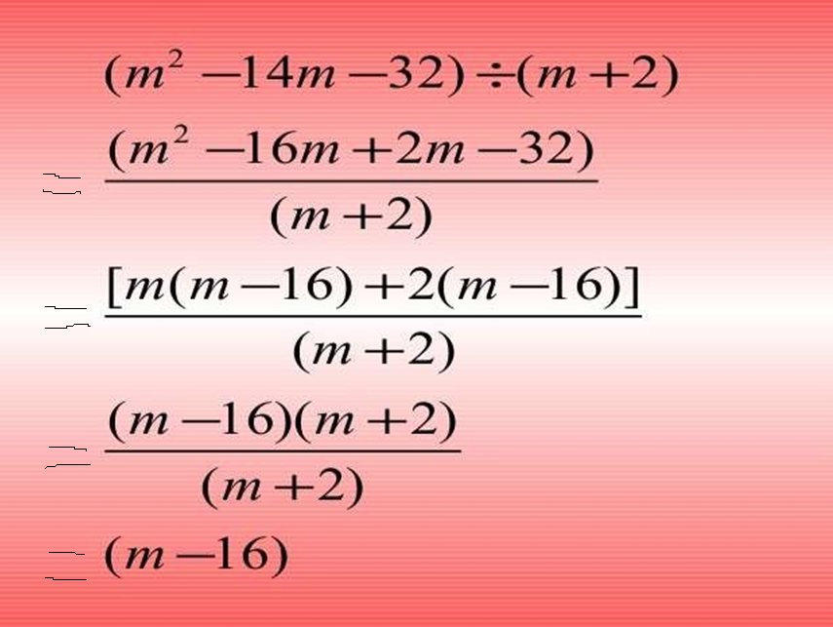

Slide 23


